Slide 1
Reflection Removal Using Ghosting Cues
Aayush Tiwari(201531031),
Sreya Mittal(201501058),
Abhijith Nair(201501169)

Slide 2
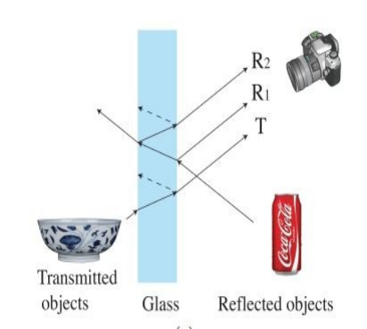
Introduction
When taking a picture through a
window pane, reflections of
objects are often captured.

Slide 3
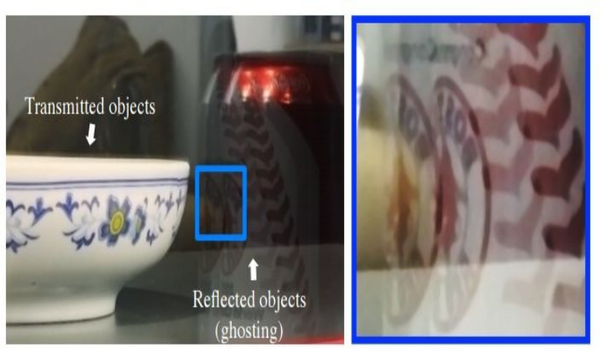

Slide 4
Challenges
Traditional imaging model:
I=T+R
As both T and R are natural, separating them is
ill-posed since both T and R are natural images and
exhibit the same statistical properties.

Slide 5
What paper accomplishes..
Separate the reflection layer using
the double reflection imaging model
with patch-based image prior
How can we do this?

Slide 6
Key idea..
Break the symmetry of T and R using Ghosting
What’s Ghosting ?
Appearance of secondary image on the main display.
Observation: Window reflection often appear
multiple times.

Slide 7
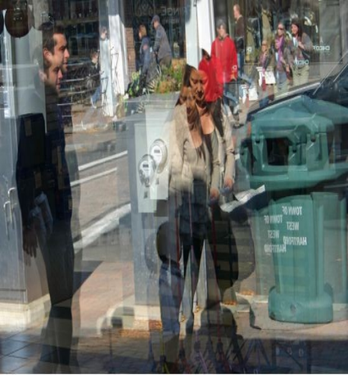
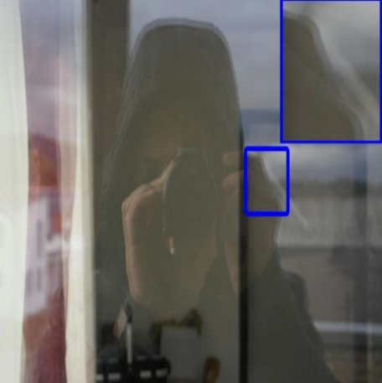

Slide 8



Modelling Ghosting
Using a two-pulse kernel k.
Parameterize k by the separation of the two reflections d and an attenuation factor c depending on the camera view angle

Slide 9
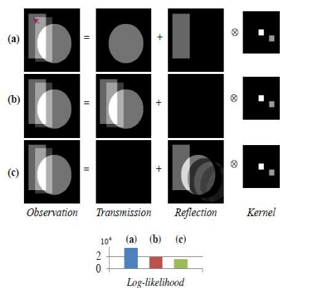
Toy Example
A synthetic example with a circle as the transmission layer and a rectangle as the reflection layer.
We compare the log likelihoods of the various possible decompositions under a GMM Model.
The log likelihood of the a) is the highest, (implying is most “Natural”) which is indeed the ground truth.

Slide 10
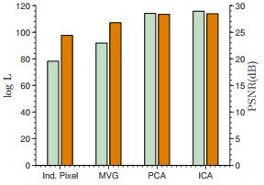
Why GMM?
It performs well for image restoration when compared to other methods.

Slide 11
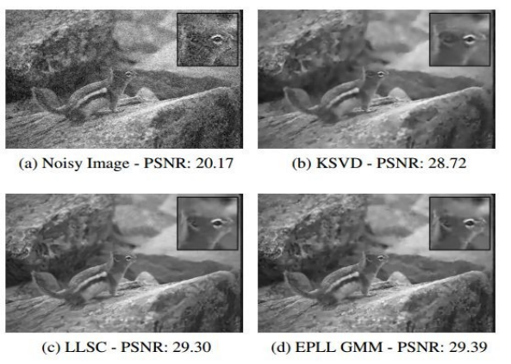
Expected Patch Log Likelihood: Image denoising

Slide 12
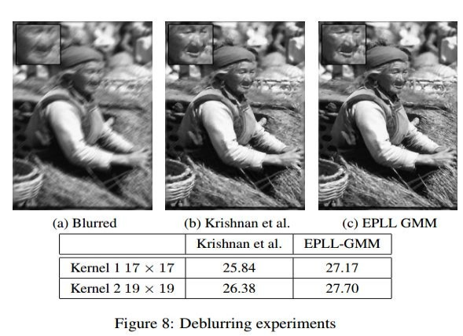
Expected Patch Log Likelihood: Image deblurring

Slide 13
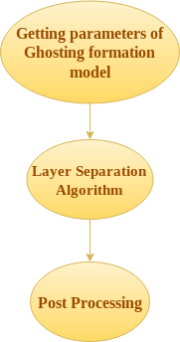
The Big Picture

Slide 14
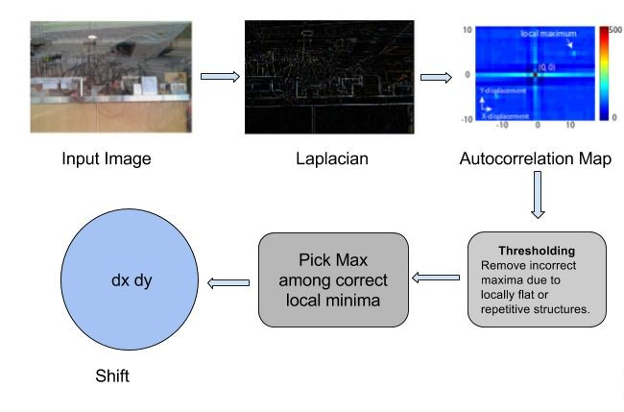
Estimating Kernel Parameters

Slide 15
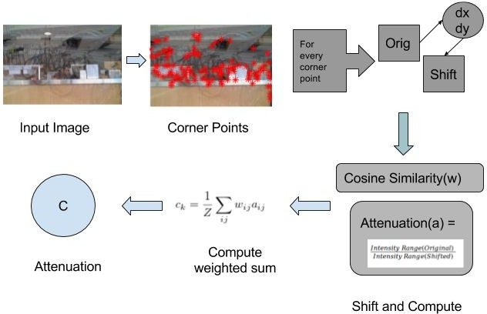
Estimating Kernel Parameters

Slide 16
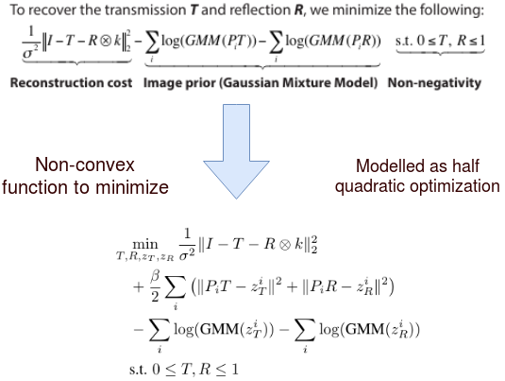
Optimization

Slide 17
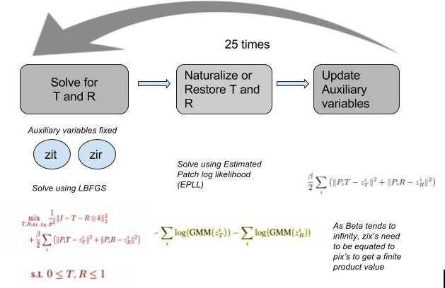
Alternating Minimization

Slide 18
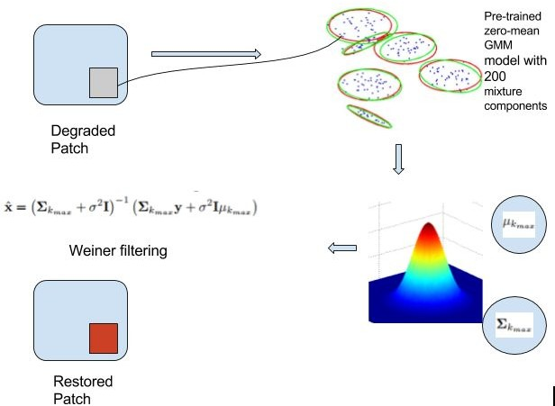
Estimated Patch Log Likelihood (EPLL)

Slide 19
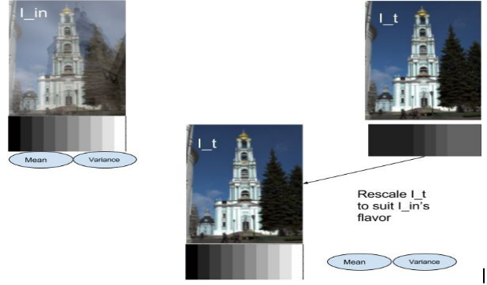
Post-processing

Slide 20
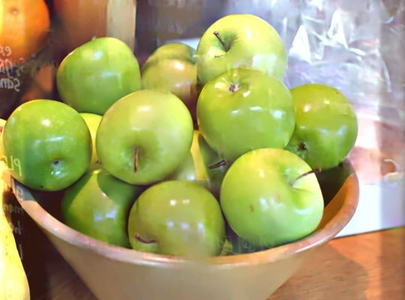
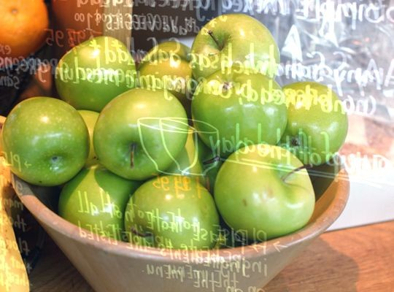
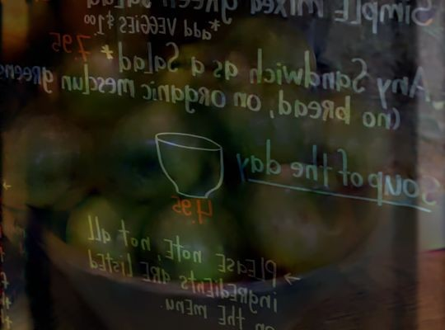
Results

Slide 22
Thank You

